Slide 1

SAP BTP ABAP on Cloud / RAP Training
DAY-13
Anubhav Oberoy
www.AnubhavTrainings.com
Follow excellence with sheer passion

Slide 2


DISCLAIMER
The training content and delivery of this presentation is confidential, and cannot be recorded, or copied and distributed to any third party, without the written consent of Anubhav Trainings

Slide 3

01
Determination
02
Validation
03
Side Effect
04
Draft
Notes:
https://pixabay.com/photos/san-francisco-transamerica-pyramid-1633203/

Slide 4

Development Flow – Processor and Approver
Fiori App – Processor
Create, update, delete, copy travel
Fiori App – Approver
Display the travel request data
Service definition
Service Binding
Service definition
Service Binding
MDE for Processor Projection
MDE for approver Projection
BDEF Projection
For Processor
Expose what is needed by a processor role in company
Behavior Definition (BDEF)
Tell RAP framework regarding our operations which needs to be supported for BO (managed)
BDEF Projection
For Approver
Expose what is needed by a approver role in company
Business Object Projection
For Processor
30 fields to internet
Business Object (definition)
Includes the Travel, Booking and Booking Supplement CDS entities
100 fields
Business Object Projection
For Approver
25 fields
www.anubhavtrainings.com

Slide 5

Data Actions in RAP
In the context of RAP, an action is a non-standard operation that change the data of a BO instance or create new BO instances. They are self implemented operations. There are two main categories of data actions can be implemented in RAP:
Non factory action: Defines a RAP action which offers the non-standard behavior and implement custom logic in handler with MODIFY clause. A non factory action can be of 2 sub types (change a property of a record)
Static – they are not bound to any instance, they are generic and can be applied to all instances, like we want to change the booking fees for all travel request as fix price during promotion period.
Instance – An action that, by default relates to a BO RAP entity instance and changes the state of BO instance. E.g. like approve or reject a travel request where user choose a instance which they want to work with.
Factory Action – A factory action used to create new BO instances. A factory action can be instance-bound (default) or static.
Instance – that copy specific values of an instance and create new instances based on copied data
Static – can be used to create instances with prefilled default values
www.anubhavtrainings.com

Slide 6
Determination
A determination modifies instance of business object based on trigger condition. Trigger condition can be modify operations such as create, update, and delete and modified field. There are 2 types of determination
on modify – will be triggered before save whenever trigger condition is met e.g. when I change booking fee
on save – will always trigger at the time of save
Steps
Add the code for defining the determination in behavior definition, we want to do it in reusable way
Use quick fix to generate the code for determination
Define a structure where we can store all the booking fees and currency code
Read all travel instances, subsequent bookings using EML
Total all booking and supplement amounts which are in common currency
Delete the values w/o any currency
Loop at all amounts and compare with target currency
Perform currency conversion
Put back the total amount
Return the total amount in mapped so the RAP will modify this data to DB
determination
Reusable block
Calculate bookingFee + Individual Booking cost
action
www.anubhavtrainings.com

Slide 7























Slide 8


































Slide 9

















Validations
Many times we would like to perform business specific checks in our application, The rap framework is only responsible to perform CURDQ operations. It does not know what are all the business rules applies to our code.
If we return FAILED and MESSAGE then the RAP will terminate the update/create and shows the message to the user on Fiori App.
www.anubhavtrainings.com

Slide 10



























Slide 11
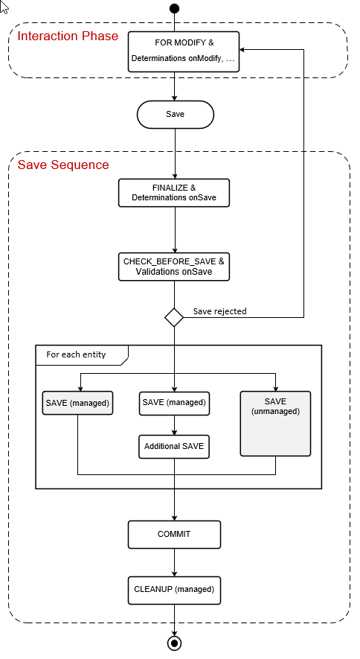
www.anubhavtrainings.com

Slide 12
Side Effects
Side effects are useful in UI scenarios based on BO which makes the Fiori element UI know/aware about the data changes in backend. Whenever data is reevaluated in backend, the frontend is unaware of that, we need to make sure that the frontend make a forceful call to GET the data back on UI.
The Fiori UI will never make an unnecessary call to perform a round trip. If we know that, a change in a field would certainly change the data in SAP system, we need to inform the same to RAP BO, so that it can make a GET call to reload the particular field value and display the updated data on UI. E.g. when we change the booking fee, or flight price under booking table, we need to reload the total price (which is getting calculated in backend using determination), this is exactly what the side effect can do for us.
www.anubhavtrainings.com

Slide 13
Draft
Draft is a very important functionality of an enterprise application, which allows us
To create a stateful application from stateless
Store intermediate data in sap system
Perform validations on-fly, increases the collaboration with our app
Device switch
The Odata V4 never allow CURD operation without having draft feature to your BO
www.anubhavtrainings.com

Slide 14
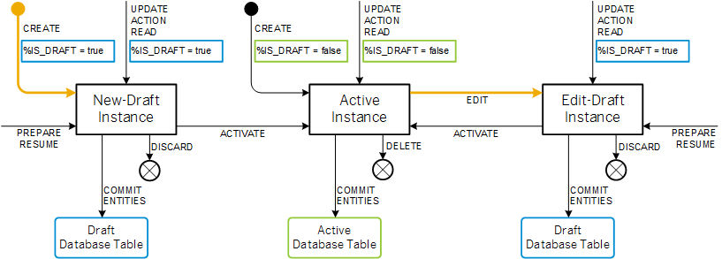
Draft Runtime
www.anubhavtrainings.com

Slide 15

Hands on SAP BTP Cloud Transport

Slide 16
www.anubhavtrainings.com
Thank You
End of Day 13
www.anubhavtrainings.com

Slide 17


We’re committed to empower you to be
#FutureReady
through powerful training solutions.
We build the workforce of the future.
250+
Corporate Clients
30,000+
Learners Trained
25000+
Learners Placed
FREE WEBINARS
Sign up for free webinars with industry experts every fortnight!
Enroll Now!
Contact us today!
https://anubhavtrainings.com

